Slide 1
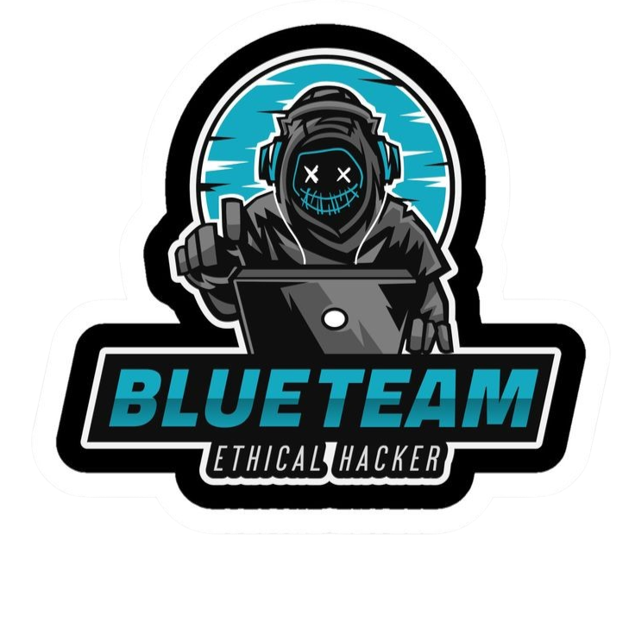

Indicator of Compromise
Eng. Mahmoud Hassan

Slide 2
Indicator of Compromise
What is Indicator of Compromise (IOC)?
It refers to pieces of evidence that suggest a system or network has been compromised by malicious activity. IOCs help cybersecurity professionals detect, investigate, and respond to potential security incidents.
Common Types of IOCs:
Malicious IP Addresses: These are IP addresses known to be used by hackers or infected computers. If your system is communicating with these IPs, it could mean you’re under attack.
Tools:
VirusTotal.
AbuseIPDB.

Slide 3
Indicator of Compromise
Common Types of IOCs:
2. Suspicious Domain Names: These are websites or URLs created to trick users or control malware. They may look real but are designed for phishing or hacking like C2 servers. For example, a fake website like "g00gle.com" instead of "google.com" to steal your login.
Tools:
URLScan.io.
PhishTank.
VirusTotal.

Slide 4
Indicator of Compromise
Common Types of IOCs:
3. File Hashes (MD5, SHA-1, SHA-256): A file hash is like a digital fingerprint. Every file has a unique hash. If a file’s hash matches a known malware hash, it’s likely infected. For example, You download a file, and its hash matches a known ransomware hash.
Tools:
VirusTotal.
Metadefender Cloud - OPSWAT.
4. Unusual Network Traffic: This is when someone logs into your system or tries to log in from a strange location or device without permission. You see a successful login from China, but you’re in Egypt.
Tools:
SIEM solution like Splunk, Q-radar or ELK Stack.
EDR like CrowdStrike Falcon, Microsoft Defender for Endpoint, SentinelOne or Carbon Black.

Slide 5
Indicator of Compromise
Common Types of IOCs:
5. Unauthorized Logins: This is when someone logs into your system or tries to log in from a strange location or device without permission. For example, You see a successful login from China, but you’re in Egypt.
Tools:
SIEM solution like Splunk, Q-radar or ELK Stack.
EDR like CrowdStrike Falcon, Microsoft Defender for Endpoint, SentinelOne or Carbon Black.
6. Modified System Files: These are changes to important system files that keep your operating system running. Hackers may change them to maintain access. For example, A critical Windows file was edited, and you didn’t make the change.
Tools:
SIEM solution like Splunk, Q-radar or ELK Stack.
EDR like CrowdStrike Falcon, Microsoft Defender for Endpoint, SentinelOne or Carbon Black.

Slide 6
Indicator of Compromise
Common Types of IOCs:
7. Registry Key Changes (Windows): The Windows Registry is like a database for system settings. If malware changes registry keys, it may try to run automatically every time you turn on your PC.
Tools:
Regshot.
8. Unusual Process Behavior: A process is a running program on your computer. If a program suddenly uses too much CPU or memory or runs in the background without reason, it might be malware. For example, A random program is using 90% of your CPU, but you didn’t open it.
Tools:
sysmon.

Slide 7
Wireshark
What is Wireshark?
Wireshark is a network protocol analyzer — a tool used to capture, analyze, and inspect data packets traveling over a network. It helps network administrators, cybersecurity professionals, and IT engineers troubleshoot network issues and detect malicious activity.
What Can Wireshark Do?
1. Capture Live Network Traffic: It records data packets in real-time from wired, wireless, or virtual networks.
2. Analyze Protocols: It supports hundreds of protocols like TCP, UDP, HTTP, FTP, and DNS.
3. Detect Cybersecurity Threats: It can reveal suspicious traffic, malware communication, or unauthorized access.
4. Filter and Search: Use powerful filters to focus on specific IPs, ports, or protocols.

Slide 8



Thank you
+201116735630
mahmoudhassan2947@gmail.com
www.linkedin.com/in/mahmoud-hassan-b4400b1b7

